Slide 1

2013 Broadband Summit
Broadband Adoption and Usage - What Have We Learned?
Sponsored by the Federal - State Joint Conference on Advanced Services with NTIA

Slide 2
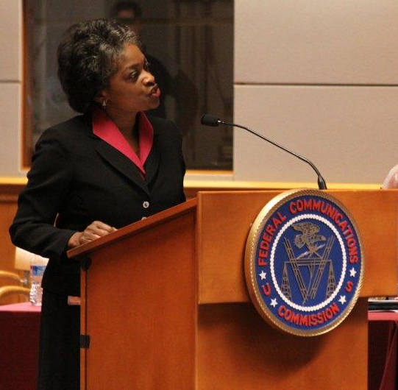
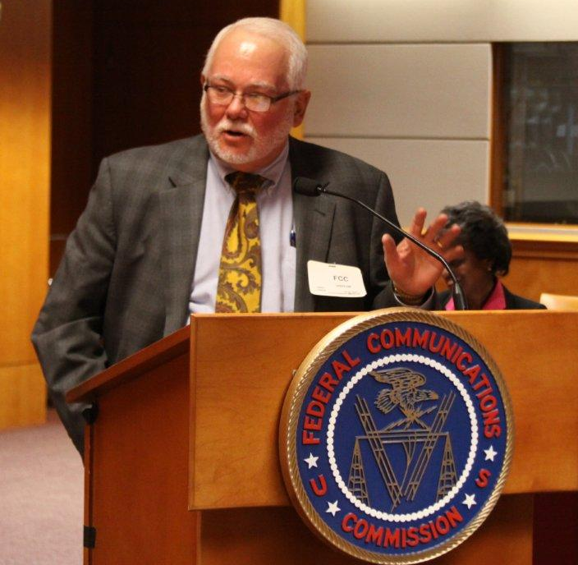
Welcoming Remarks
Commissioner Mignon Clyburn
Federal Communications Commission
Commissioner Larry Landis
Indiana Public Service Commission

Slide 3
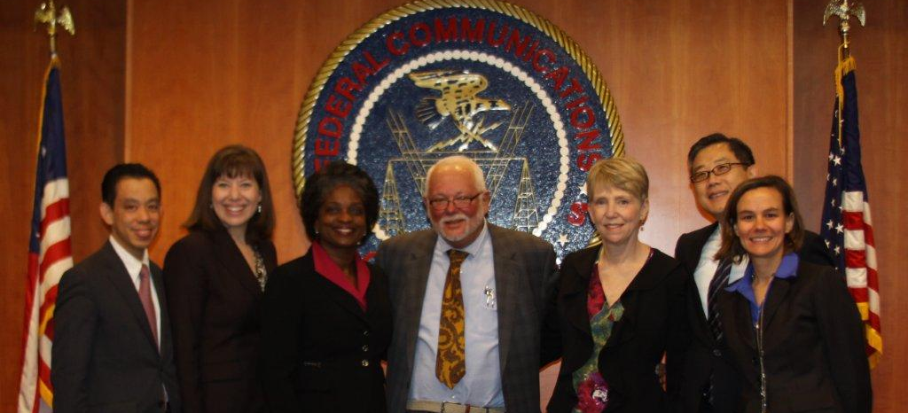
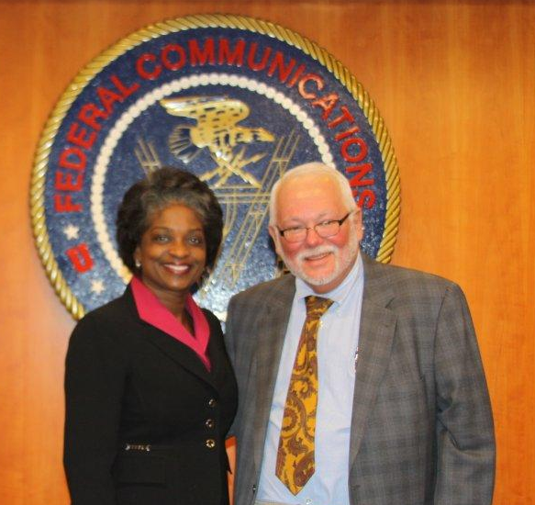
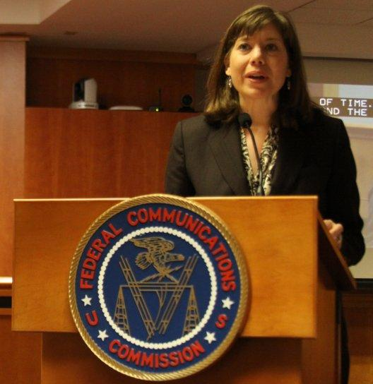
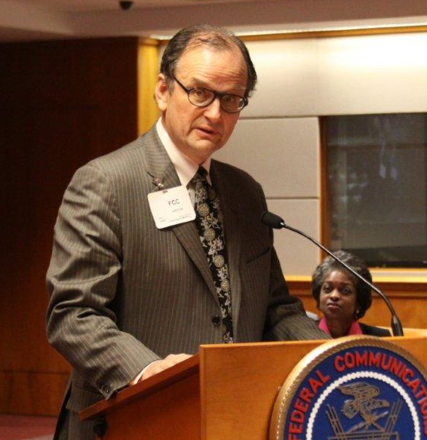
Geoffrey G. Why, Angela Kronenberg, Commissioner Clyburn, Commissioner Landis,
Laura Breeden, Kalun Lee and Garnet Hanly
Commissioner Clyburn and
Commissioner Landis
Angela Kronenberg
FCC
Commissioner Philip B. Jones
Washington State Utilities and
Transportation Commission

Slide 4
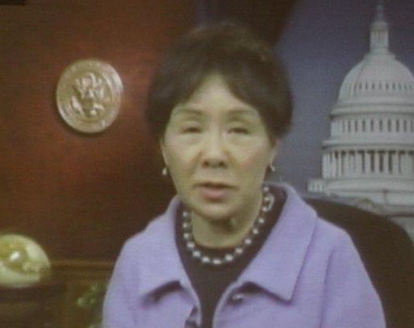
Congresswoman Doris Matsui (CA)
via video recording

Slide 5
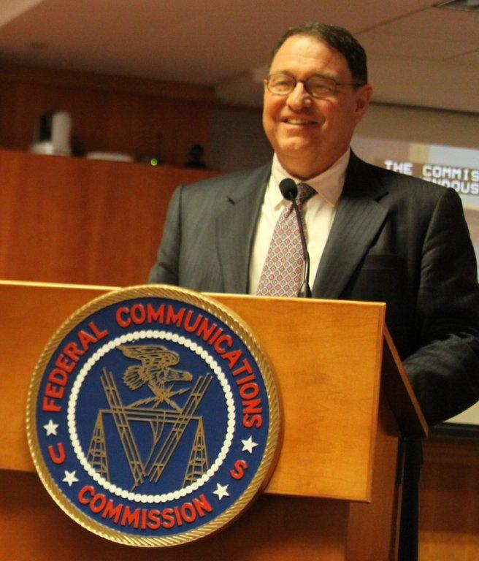
Secretary Larry Strickling
National Telecommunications and Information Administration

Slide 6
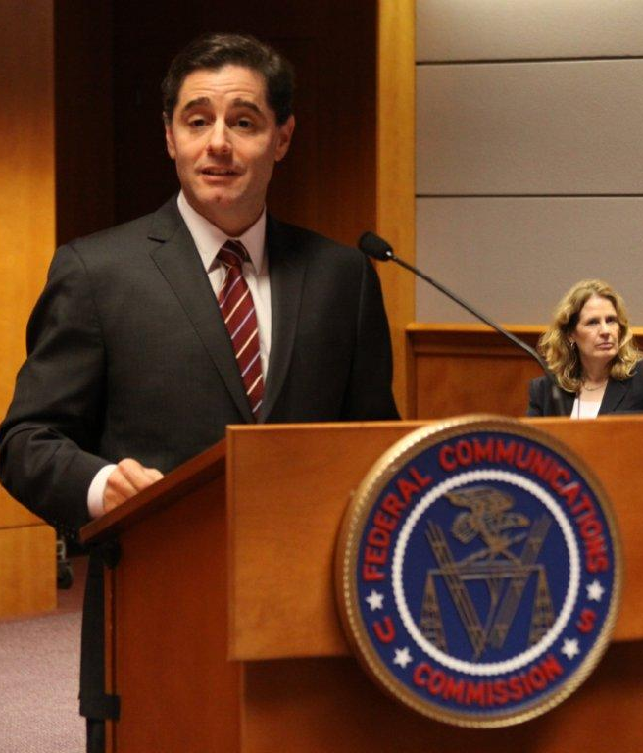
Chairman Julius Genachowski
Federal Communications Commission

Slide 7
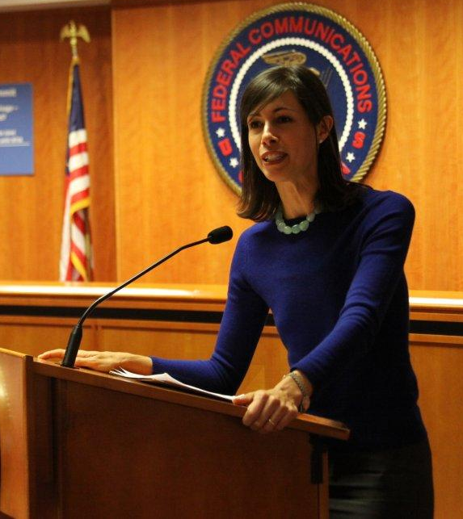
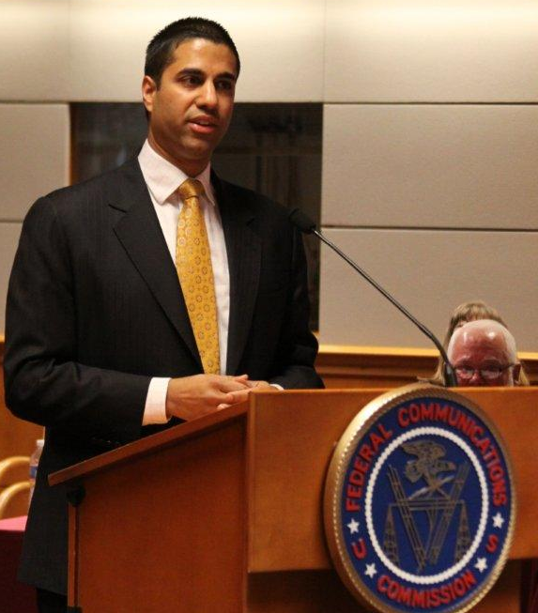
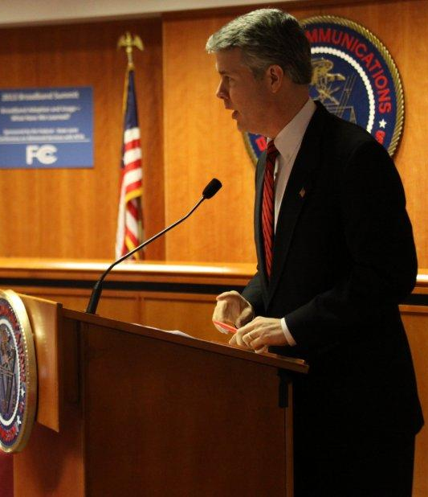
Commissioner Jessica Rosenworcel
FCC
Commissioner Ajit Pai
FCC
Commissioner Robert McDowell
FCC

Slide 8
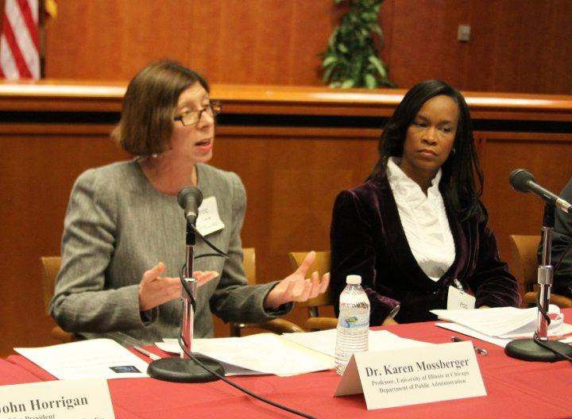
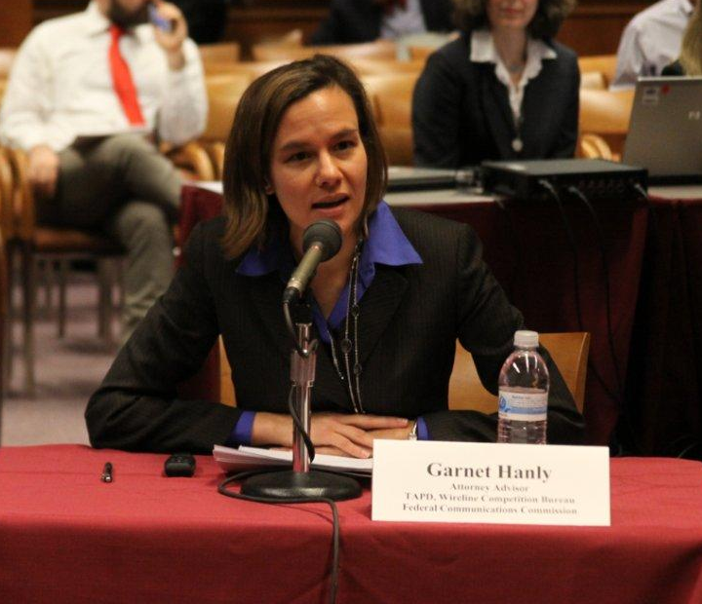
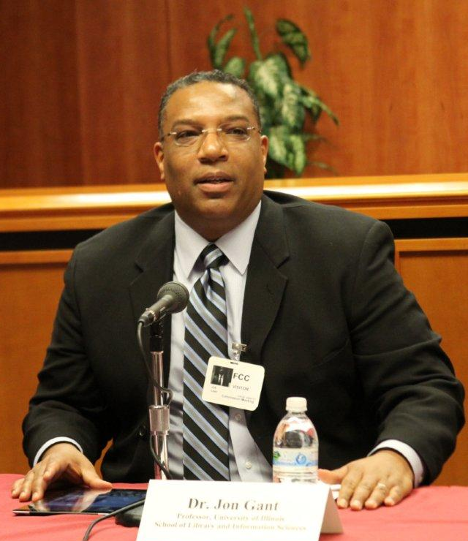
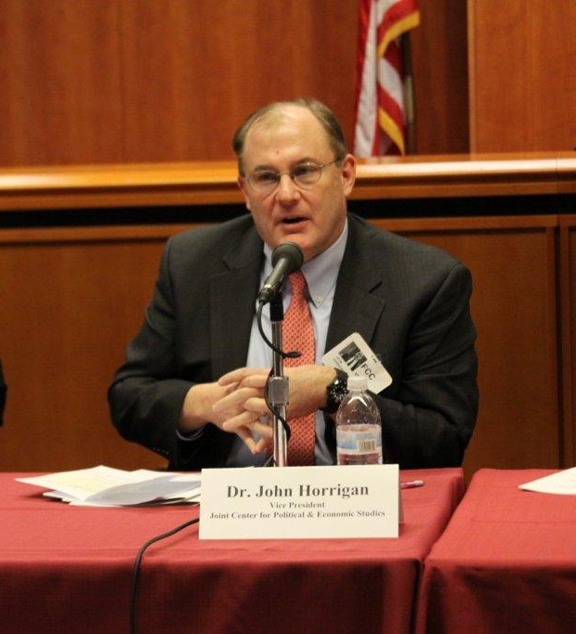
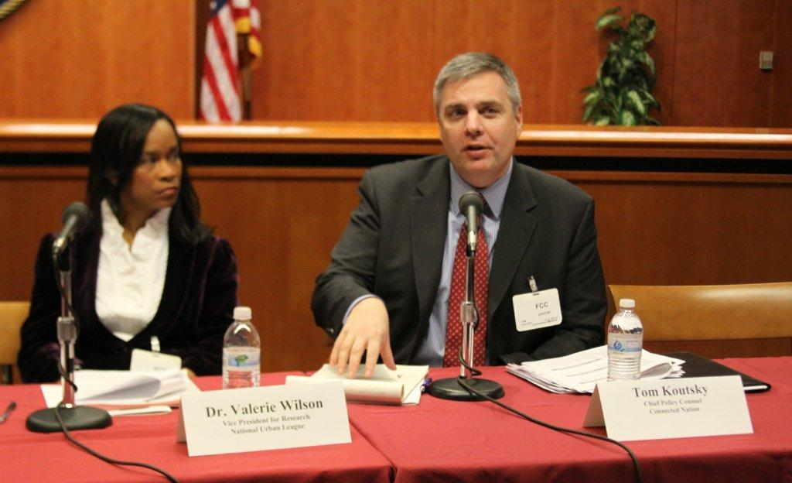
Panel 1: What have we Learned from Academic Studies on How to Close the Broadband Adoption Gap
Dr. Karen Mossberger and Dr. Valerie Wilson
Garnet Hanly
Moderator
Dr. Jon Gant
Dr. Valerie Wilson and Tom Koutsky
Dr. John Horrigan

Slide 9
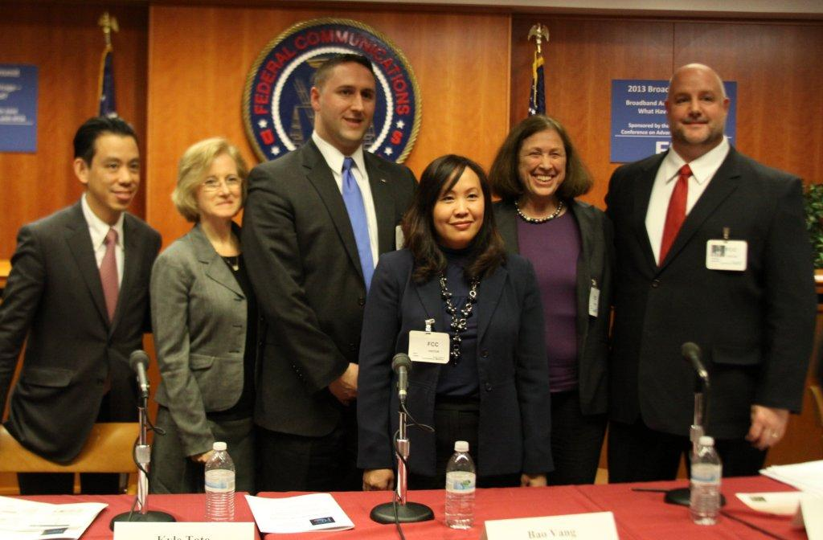
Panel 2: Discussion of Best Practices Learned from Implementing
Broadband Adoption Programs Within Different Communities
Commissioner Geoffrey Why (MA), Moderator, Deb Socia, Kyle Toto, Bao Vang, Sybil Boutilier, and Derrick Bulawa

Slide 10
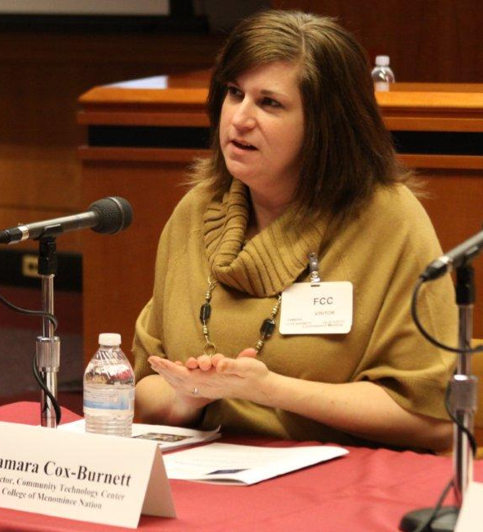
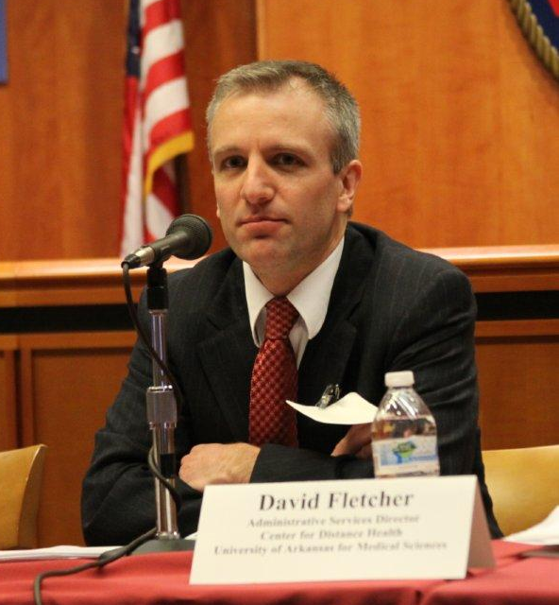
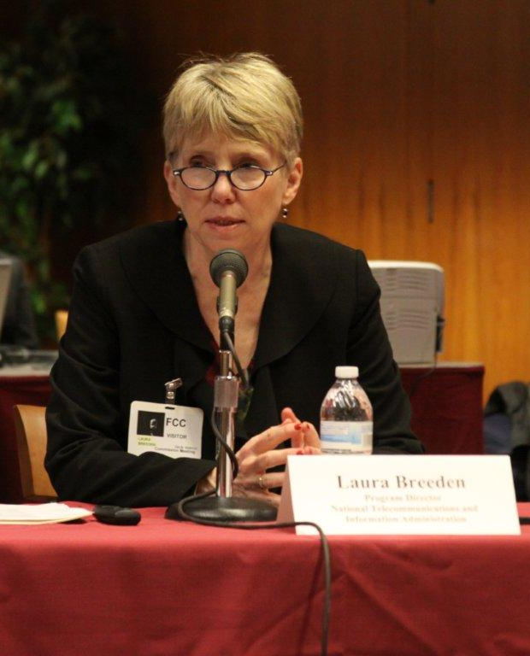
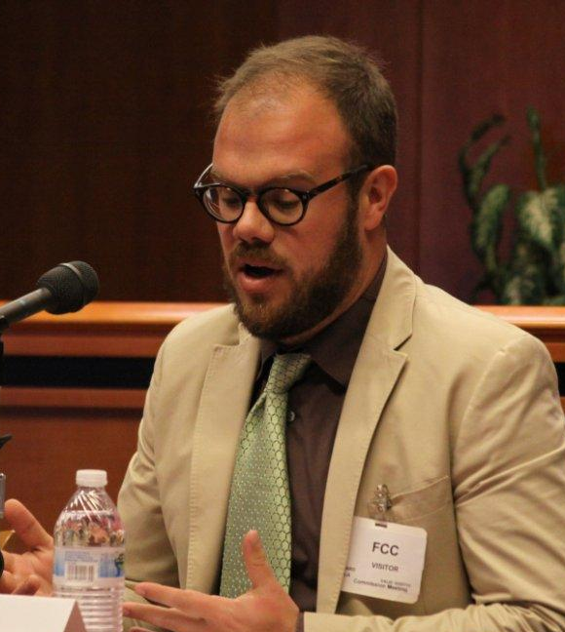
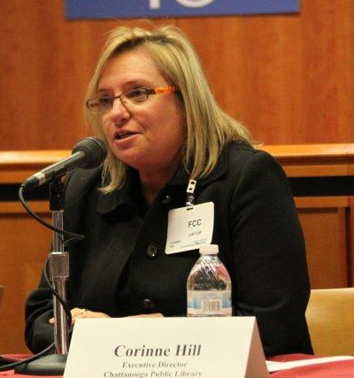
Panel 3: Discussion of Best Practices Learned from Implementing
Broadband Adoption Programs Within Different Communities
Tamara Cox-Burnett
David Fletcher
Laura Breeden
Moderator
Richard Abisla
Corinne Hill
Richard Abisla

Slide 11
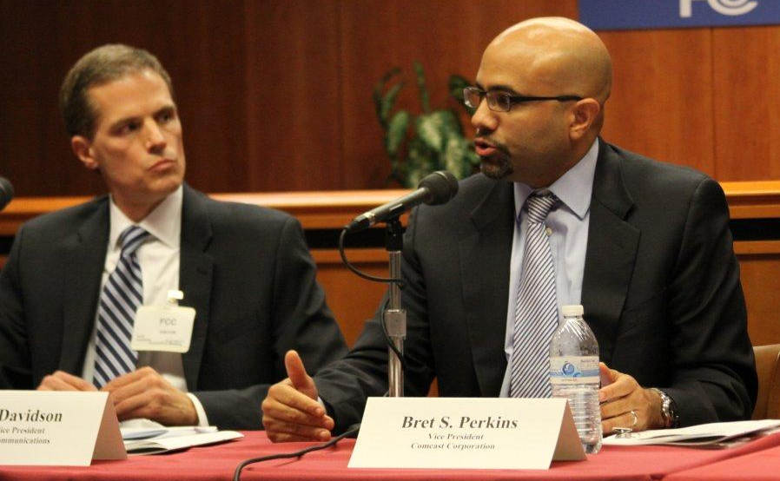
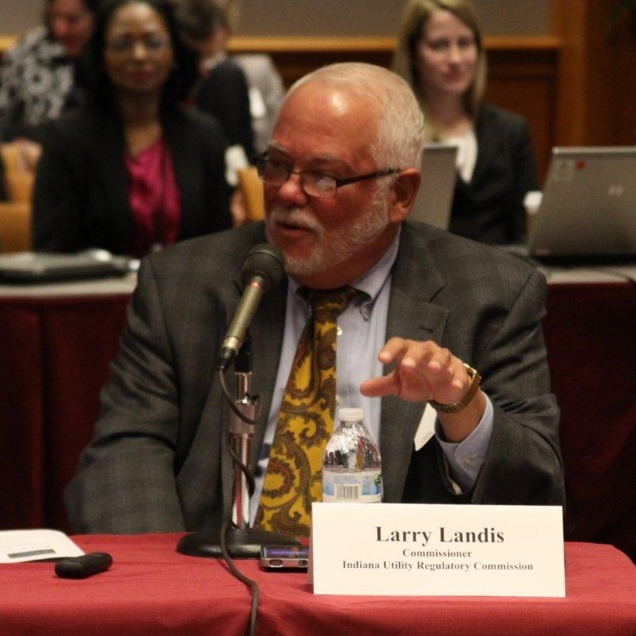
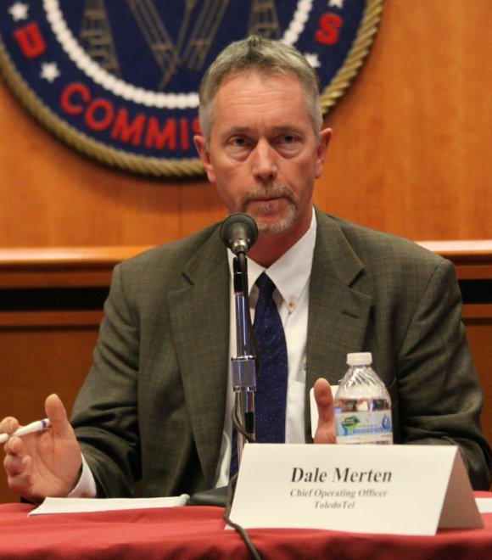
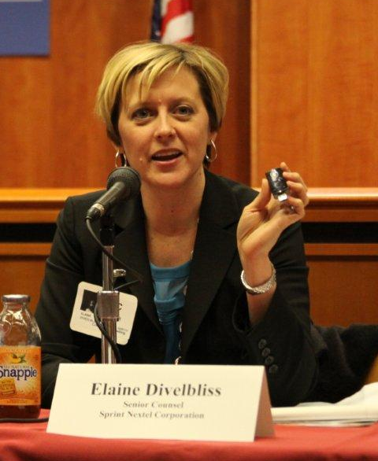
Panel 4: Discussion of Industry Best Practices to Increase Broadband Adoption Among the Various Technologies
Dave Davidson and Bret Perkins
Commissioner Larry Landis
Moderator
Dale Merten
Elaine Divelbliss

